Slide 1

A Single Pattern to Drastically Improve Your Test Automation
Nikolay Advolodkin
QA Automation Engineer
www.ultimateQA.com
@Nikolay_A00
1

Slide 2

What is one problem that most of us face with functional test automation?

Slide 3
Poll: How many tests can you run per day that will give the correct result with 95% accuracy?
5000+

2
1001 - 5000

3
501 - 1000

2
101 - 500

4
51 - 100

5
0 - 50

20
3

Slide 4
Poll: What is a problem that you have with test automation?




Flaky tests (6)

Framework (6)
Lack of knowledge (6)
Other, one off issues
Synchronization (4)
4

Slide 5

Why is functional test automation so flaky?

Slide 6
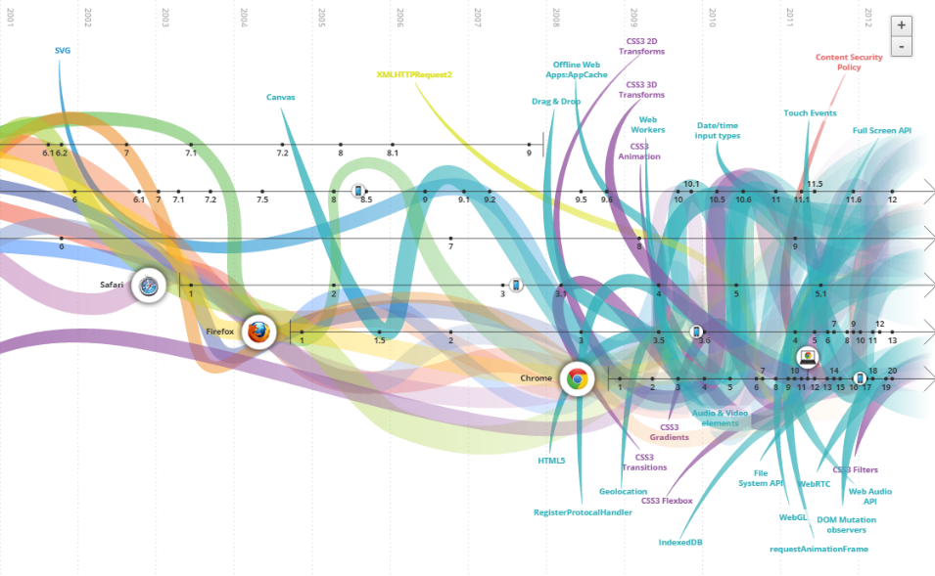
User Experience
SVG


Canvas
Drag & Drop


Touch Events
AJAX


Angular JS
http://www.evolutionoftheweb.com/

Slide 7

How can Automation Engineers handle such an evolving world?

Slide 8

“The only thing constant in software development is change.”

Slide 9
Tools Used
Version
Firefox
40.0
Selenium Builder
3.1.2
Visual Studio
2015
Selenium Webdriver
2.53.1
NUnit
3.4.1.0
9

Slide 10
Record and Replay: How many tests need to be updated due to a change in AUT?
Change
Agents
How many tests need to be changed?
Driver Initialization
All
Url
All
Locators
All
User names/passwords
All
Synchronization issues
All
10

Slide 11
Reusable
Portfolio Four
Lemon drops oat cake oat cake sugar plum sweet gingerbread chocolate cake gingerbread.
Methods
Resilient
Portfolio Five
Lemon drops oat cake oat cake sugar plum sweet gingerbread chocolate cake gingerbread.
Advantages of using Keyword Driven Approach

Slide 12
Method for every action
Portfolio Four
Lemon drops oat cake oat cake sugar plum sweet gingerbread chocolate cake gingerbread.
Too much in 1 file
Flow changes break all tests
Portfolio Five
Lemon drops oat cake oat cake sugar plum sweet gingerbread chocolate cake gingerbread.
Disadvantages of using Keyword Driven Approach

Slide 13




So what can I do then????

So unstable!!
Give me the answer already
It’s Brittle bro!
Arghhhh
13

Slide 14

Page Object Pattern

Slide 15
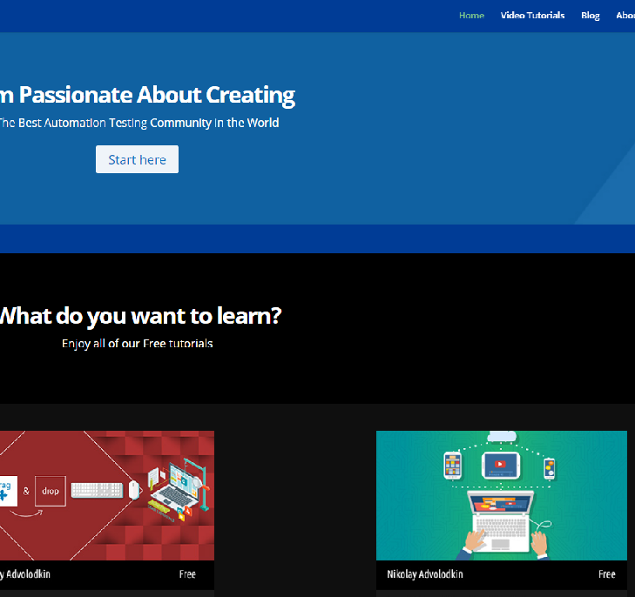
Page Object Pattern
Object – Page.cs

Slide 16
Page Object Pattern
Use your code to interact with the application page just like you would interact with it manually
Page.GoToVideoTutorials()
Page.ClickStartHereButton()

Slide 17
Maintainable
Readable Tests
Abstraction
Logical
Follows Good Design Principles
Advantages of Page Object Pattern

Slide 18
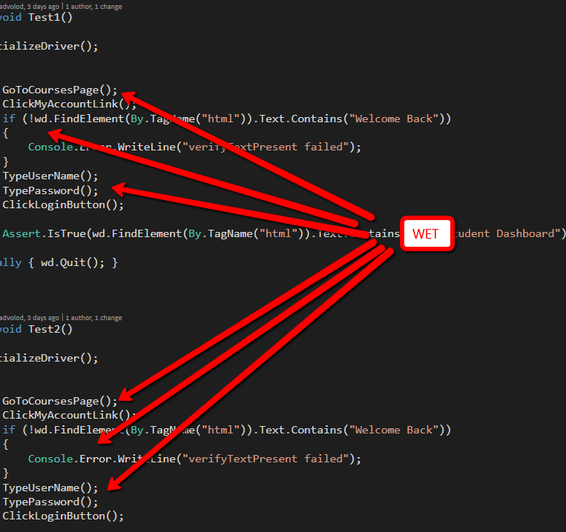
DRY – Don’t Repeat Yourself

Slide 19

“Duplication is the primary enemy of a well-designed system”
Martin, Robert

Slide 20
Many different options
Portfolio Four
Lemon drops oat cake oat cake sugar plum sweet gingerbread chocolate cake gingerbread.
Increased barrier to entry
Requires constant improvement
Portfolio Five
Lemon drops oat cake oat cake sugar plum sweet gingerbread chocolate cake gingerbread.
Disadvantages of using Page Objects

Slide 21
3 Actionable Tips

Start Using Page Objects

Use Test Driven Development

Stop being WET
21

Slide 22
Resources
Code and Slide Deck - http://wp.me/P7absY-8j
Martin, Robert C.. Clean Code: A Handbook of Agile Software Craftsmanship
(Kindle Locations 4076-4077). Pearson Education. Kindle Edition.
Selenium Wiki on Page Objects
Martin Fowler on Page Objects
Dave Haeffner on Page Objects
22

